Slide 1

Are Knowledge and Reference in Multilingual Language Models Cross-Lingually Consistent?
Xi Ai*, Mahardika Krisna Ihsani*, Min-Yen Kan

Slide 2
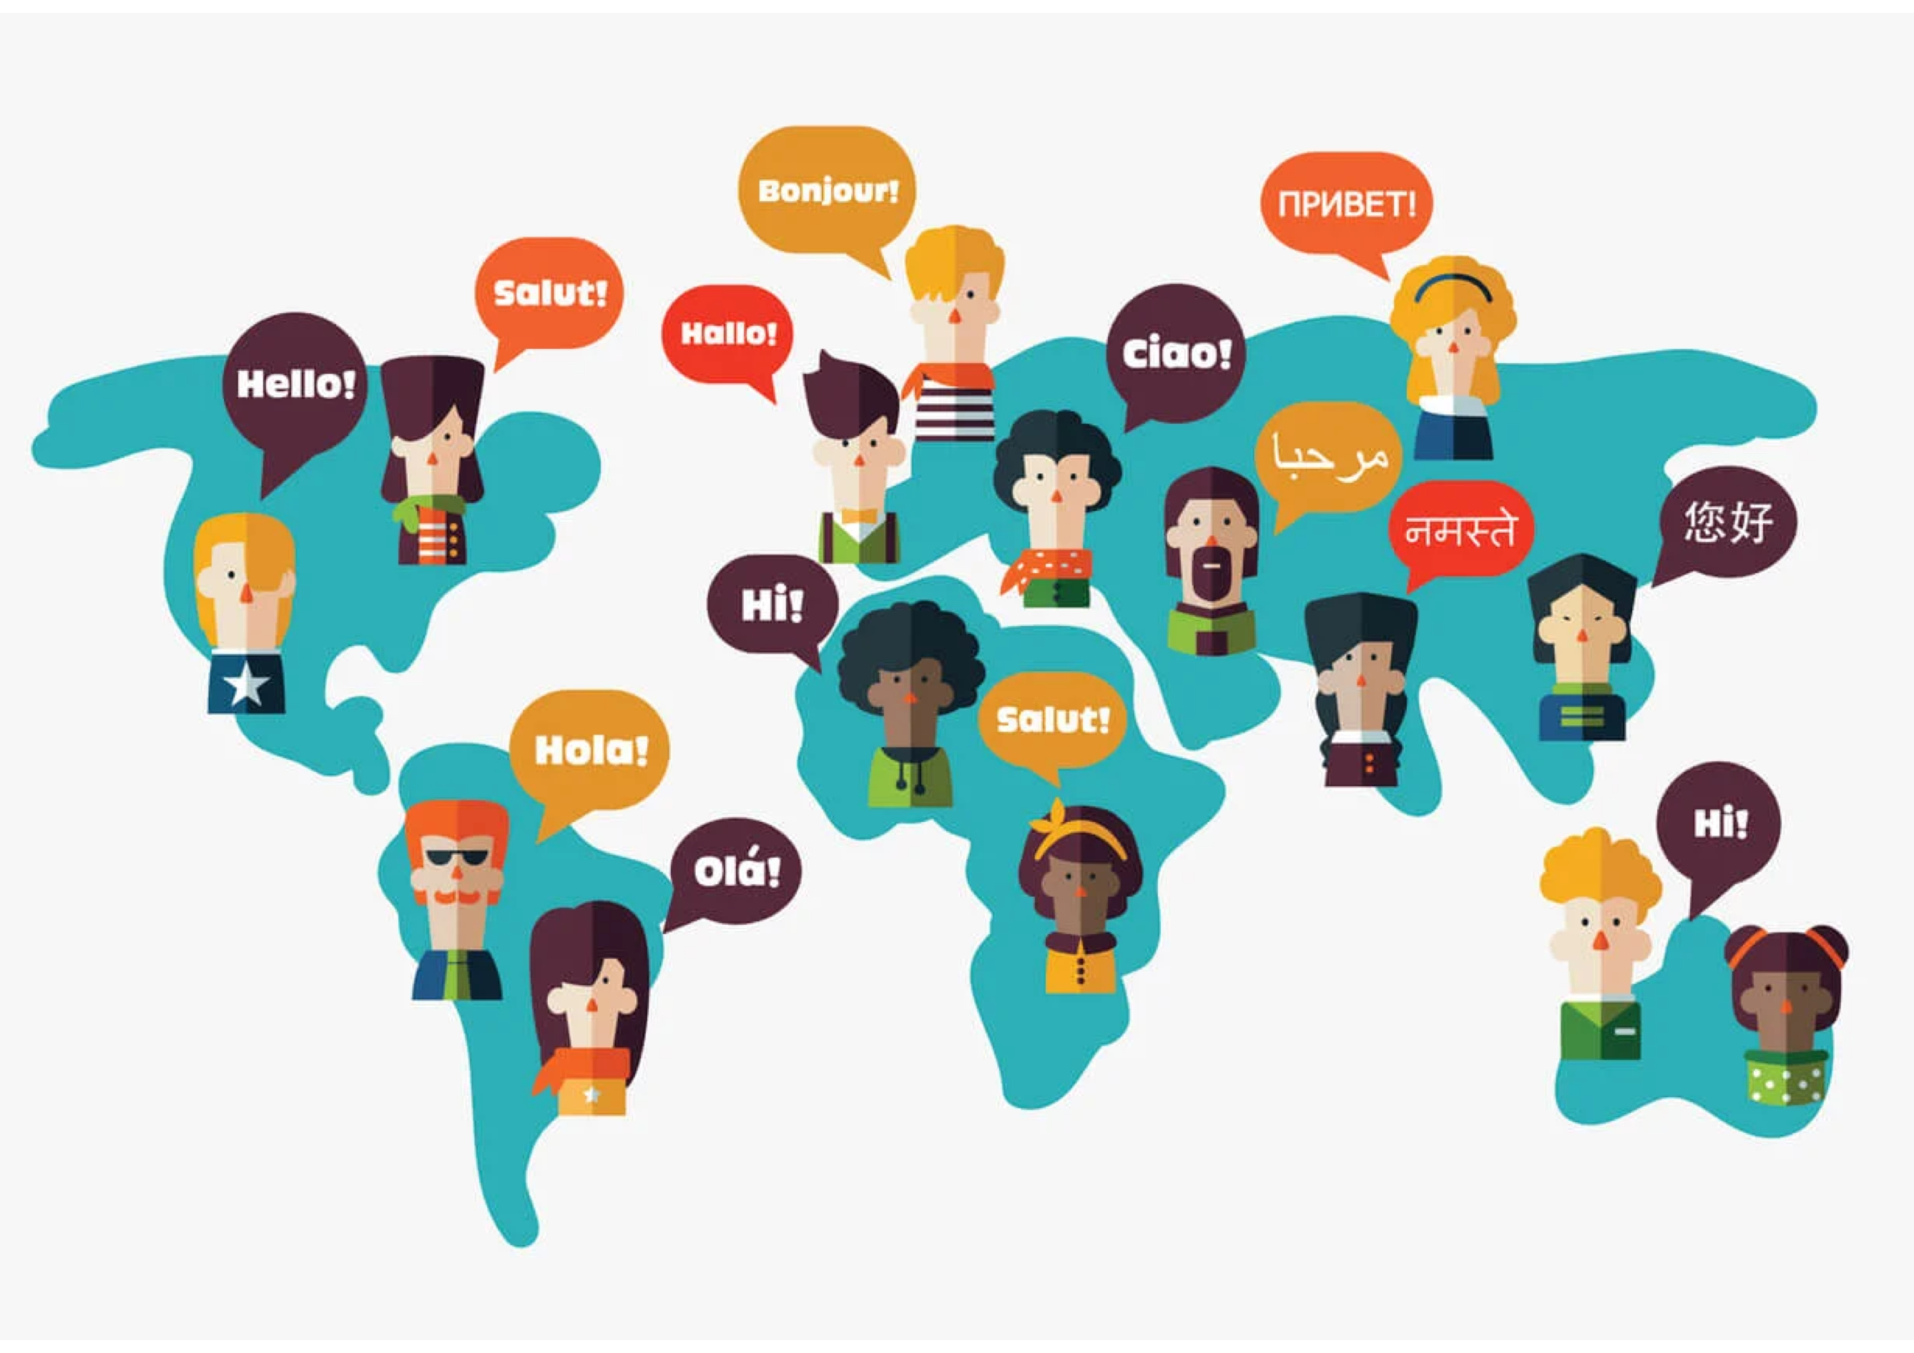
Language Diversity and Knowledge Consistency
A salient aspect of humanity is that, while people may speak different languages, they can share common references and knowledge.
We are thus interested in analyzing, evaluating, and interpreting cross-lingual consistency for factual knowledge.

Slide 3
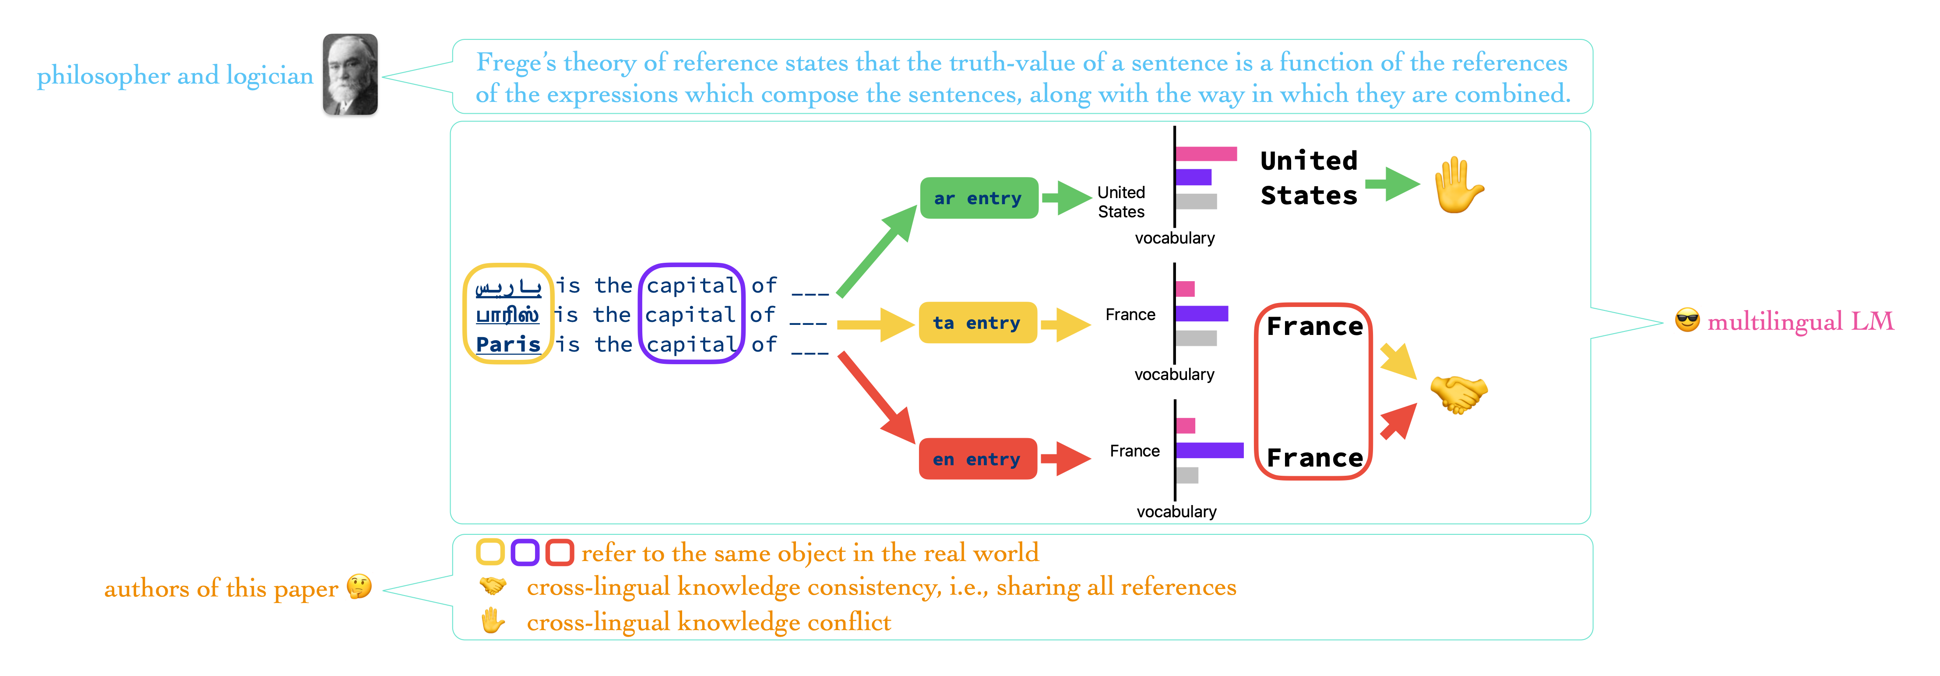
Method
Measure consistency evolution by quantifying the distribution difference between two code-mixed, coreferential statements for each layer’s output.

Slide 4
Setup
Model
Encoder models (xlm-r from 0.3B to 10B)
Encoder-Decoder models (mT0 from 0.6B to 3.7B, mT5 from 0.6B to 3.7B)
Decoder models (Llama3-instruct 1B \& 8B)
Dataset
mLAMA provides parallel triples (object, predicate, subject) in 53 languages written in cloze, completion task format (e.g., “Paris is the capital of ”) to query knowledge in zero-shot settings.
Consistency Metrics
Logit Lens (multiply representations by embeddings for distributions over the vocabulary)
RankC without output domain (Weighted Top-5 distritbuion)
Accuracy (Top-1)
CKA similarity

Slide 5
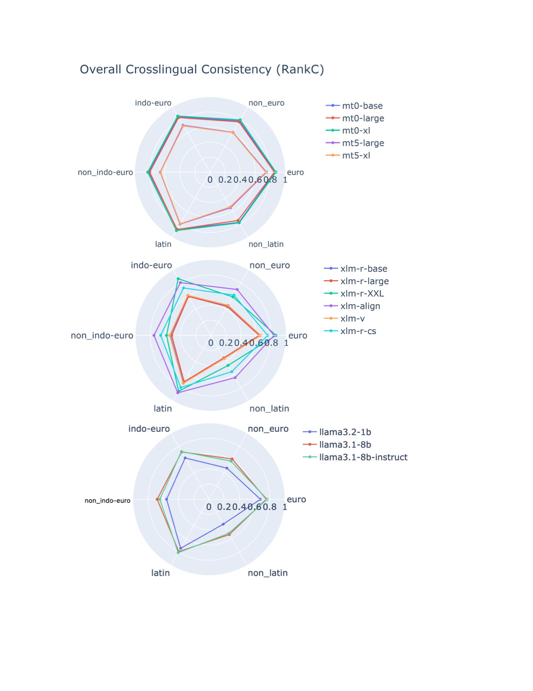
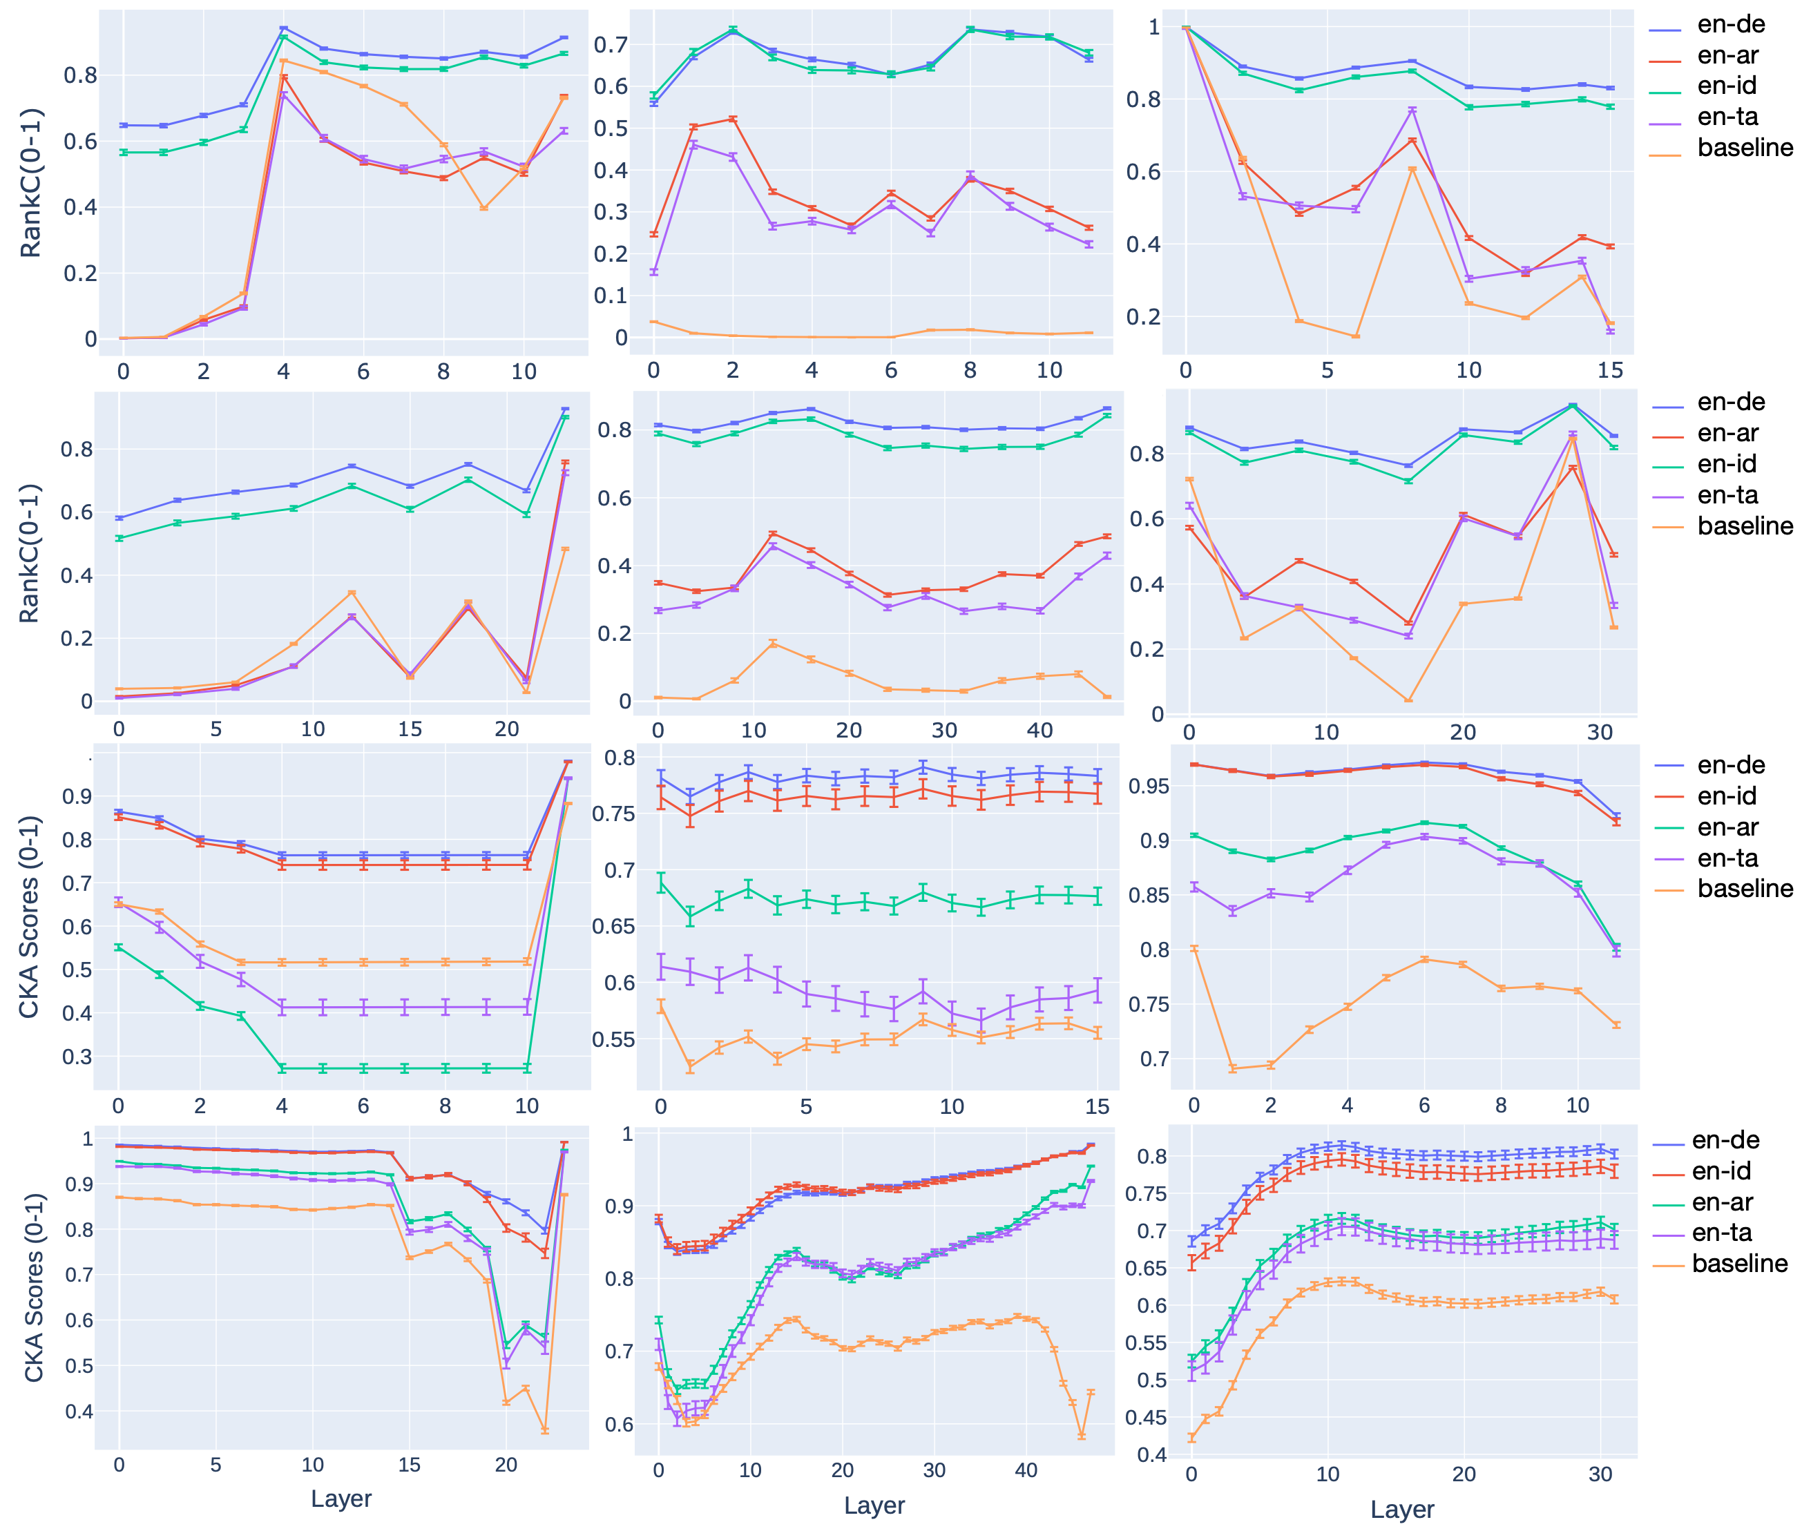
Findings
Consistency bottlenecks and issues tied to language characteristics, scripts, and training biases through layer-wise analyses and interpretability approaches, which potentially prevent cross-lingual consistency improvements and gains from scaling.
Method
We compute the consistency metrics for each layer’s representation and organize the results from the final output into 6 bins.
Consistency vs Language characteristics and scripts
Consistency evolution over layers(L: Encoder, M: Encoder-Decoder,R: Decoder)

Slide 6
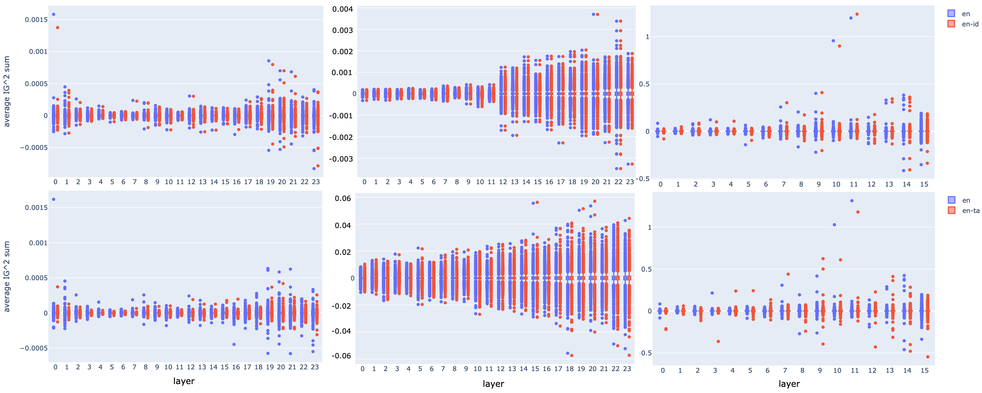
Findings
Languages partially sharing feed-forward neurons at all the layers.
Method
We take the activated neurons (IG2 scores) into account.

Slide 7
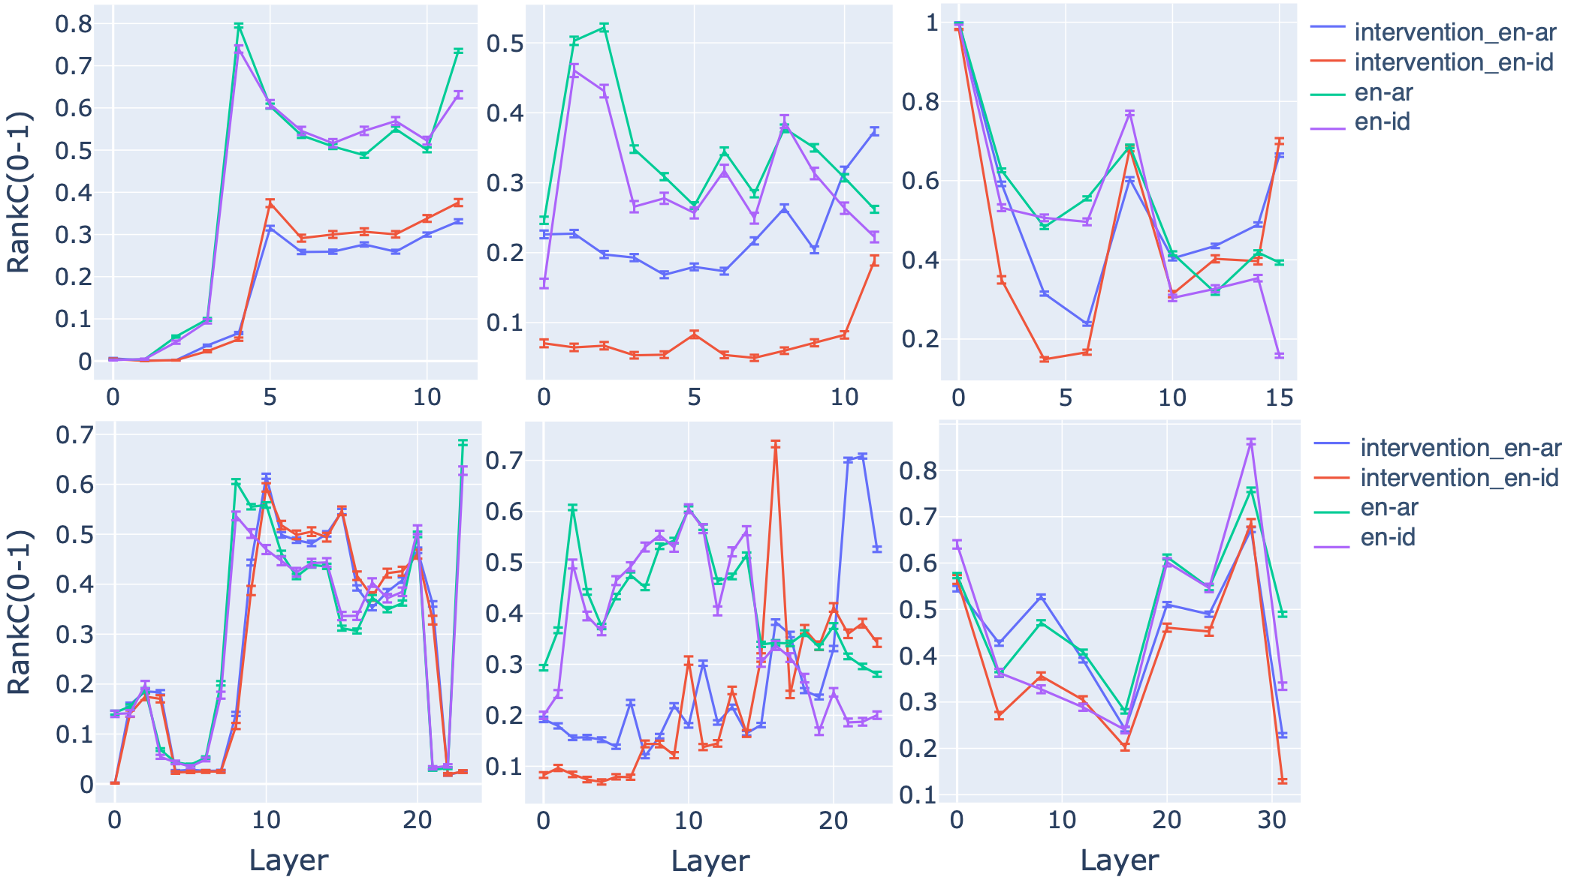
Findings
There is a partial causality from adding language biases (of high-resource languages) to improving cross-lingual knowledge consistency. Directly adding bias via representation patching could be a potential method to calibrate consistency in the test time.
Method
We patch English-biased activation
to other languages.

Slide 8
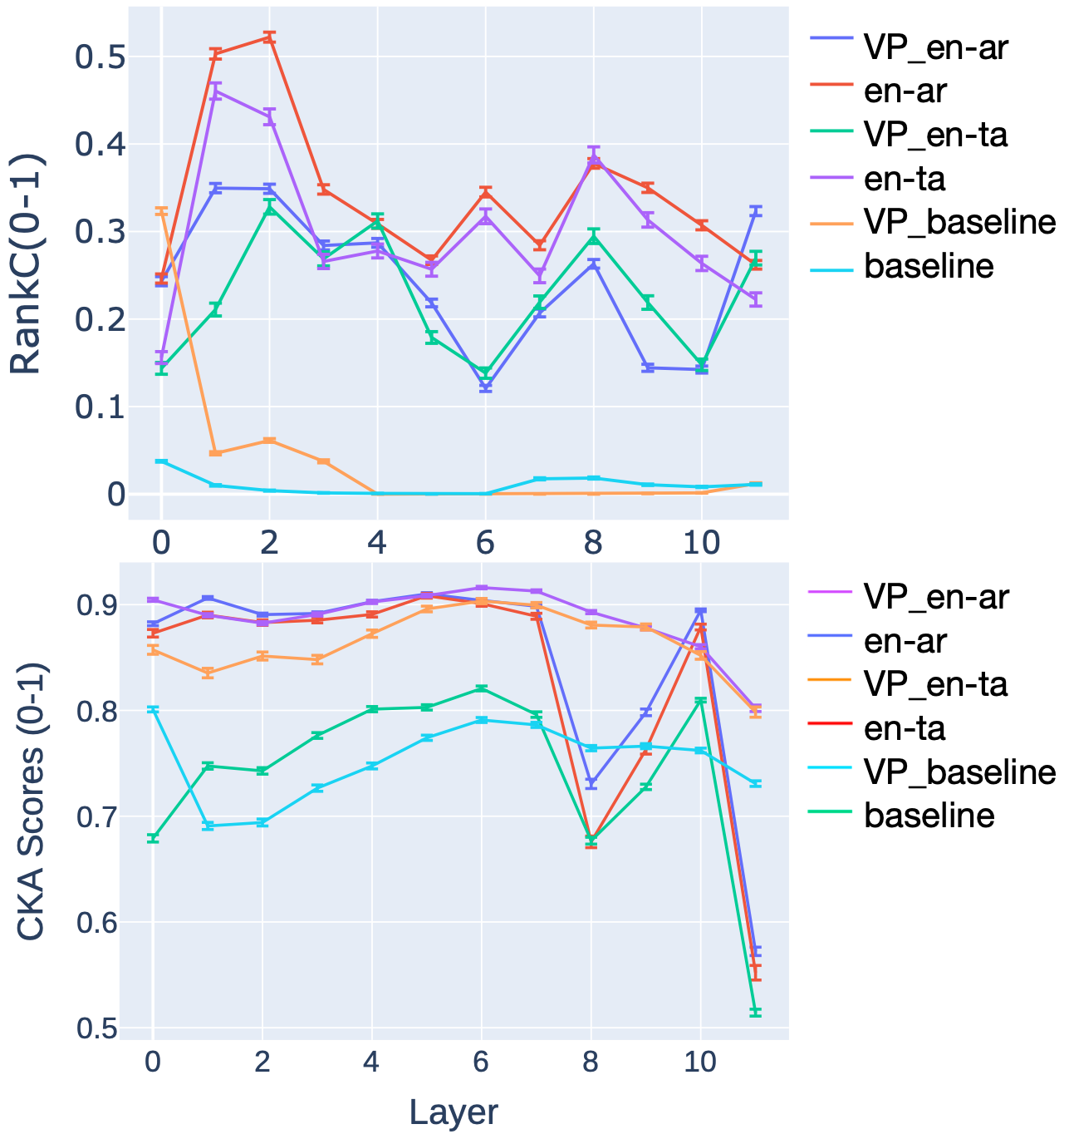
Findings
Shared language scripts contribute to cross-lingual consistency, especially for encoder and decoder models, but it is not a necessary condition to achieve it. Reducing script overlaps by expanding vocabulary size slightly improves the consistency yet it helps to improve the consistency for some low-resource languages.
Method
We compare a base model with a vocabulary-expended model (VP-x) to isolate the vocabulary factor or the shared-script factor.

Slide 9
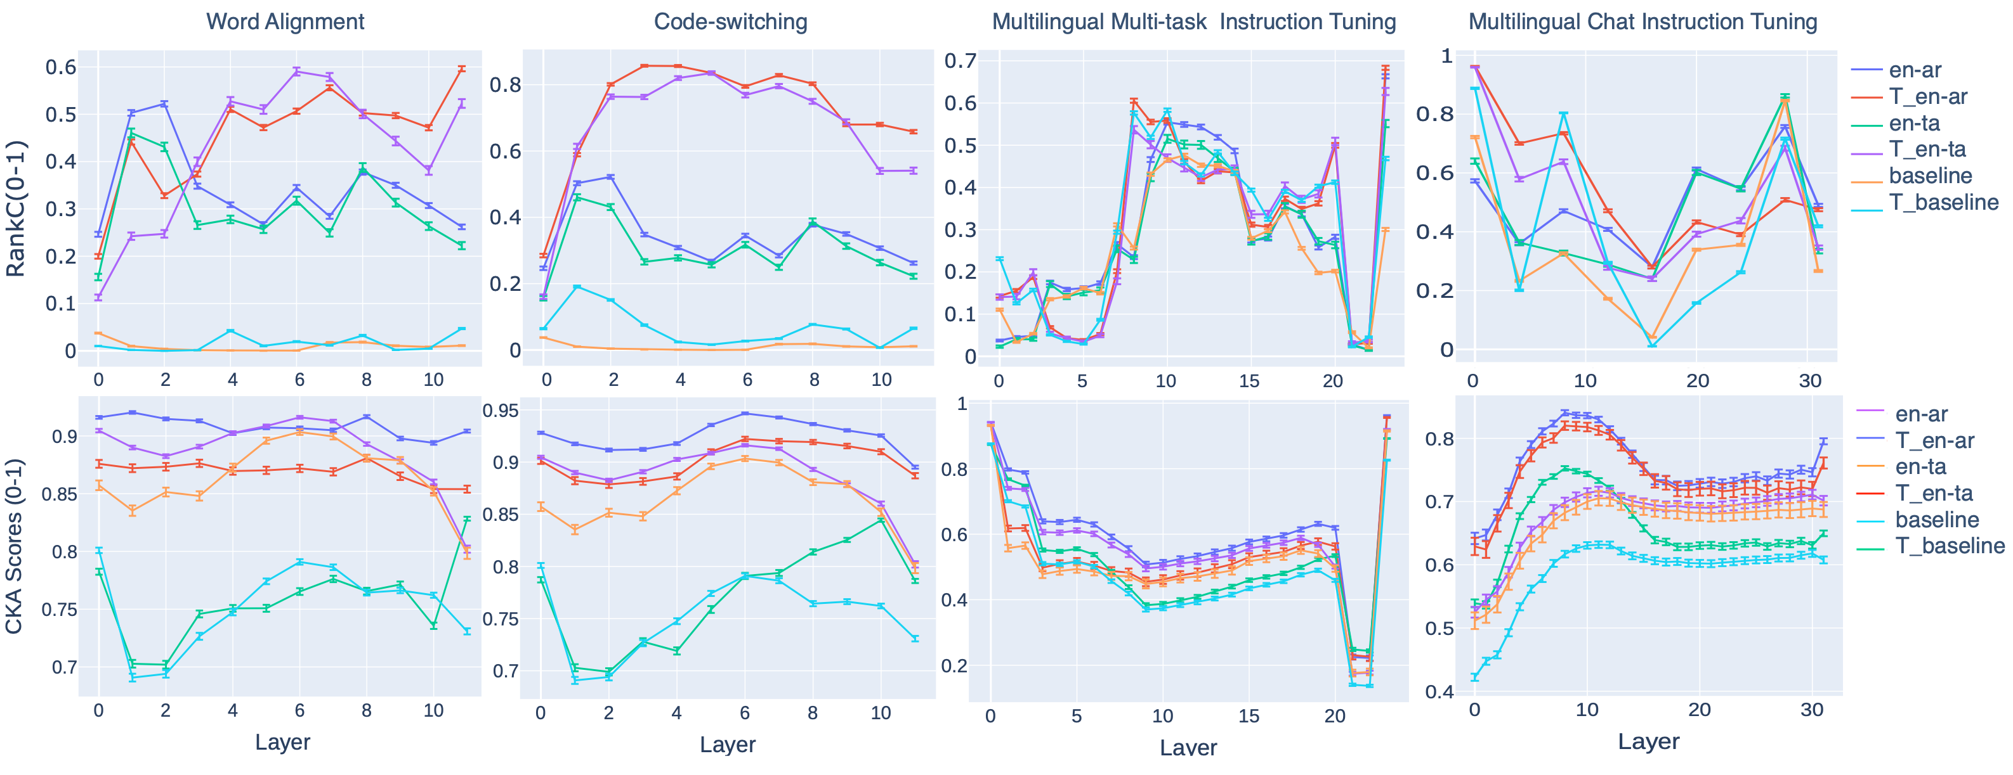
Findings
Cross-lingual supervision can alleviate the consistency bottleneck to enhance alignments between coreferential entities, which can be achieved by training with an explicit alignment objective or a code-switching objective. On the other hand, parallel samples providing cross-lingual generalization supervision offer limited gains to consistency.
Method
We examine tuned models that show promising performance in multilinguality.

Slide 10
Conclusion
Multilingual models uncovers a consistency bottleneck whereby the consistency does not grow monotonically on each layer.
Key Factors
model architectures
training strategies
deep semantic alignments
Promising directions
test-time calibration
training with cross-lingual alignment objectives
Necessary but not sufficient conditions
Cross-lingual representations
shared scripts
parallel samples

